Slide 1
Notes:
James and Manuela

Slide 2
Admin in a day: Managing PowerApps and Microsoft Flow in your enterprise
James Oleinik
Principal Program Manager Manuela Pichler Senior Program Manager

Slide 3
Framing Today
Secure
Monitor
Alert & Action
Deploy
9:00 - 10:45
10:45 - 12:30
Lunch
1:15 – 3:15
3:15 – 5:30
Welcome & Logistics
Presentation (45)
Questions (15)
Hands on Lab (30)
Questions + Break (15)
Presentation (30)
Questions (15)
CoE Starter Kit Demo (15)
Hands on Lab (45)
Questions + Lunch (45)
Presentation (30)
Questions (15)
Hands on Lab (60)
Questions + Break (15)
Presentation (30)
Questions (15)
Hands on Lab (60)
Wrap-up (30)

Slide 4
OLD TIMINGS Framing Today
Secure
Monitor
Alert & Action
Deploy
Presentation (60)
Questions (15)
Hands on Lab (60)
Questions + Break (20)
Presentation (30)
Questions + Lunch (50)
Hands on Lab (30)
CoE Starter Kit Demo (15)
Questions + Break (15)
Presentation (30)
Questions (15)
Hands on Lab (30)
CoE Starter Kit Demo (15)
Questions + Break (15)
Presentation (15)
Questions (15)
Hands on Lab (30)
Wrap-up (30)

Slide 5
Expertise: Show of Hands
Familiarity with PowerApps 1-5
Not familiar with it yet
Have seen presentations, done trainings, built an app
Have a PowerApps solution in production
Have multiple PowerApps solutions in production
Working on a Centre of Excellence

Slide 6
Job Function: Show of Hands
Job Function 1-5
O365 Admin
D365 Admin
Central IT
Line of Business IT
Power User

Slide 7
Framing Today
Module 1: Secure
Understand the basics of security & administration
Module 2: Monitor
Reporting and telemetry
Module 3: Alert & Action
Action through Automation
Module 4: Deploy
Application Lifecycle Management & Automated Dev Ops

Slide 8
Framing Today
Secure
Monitor
Alert & Action
Deploy
9:00 - 10:45
10:45 - 12:30
Lunch
1:15 – 3:15
3:15 – 5:30
Welcome & Logistics
Presentation (45)
Questions (15)
Hands on Lab (30)
Questions + Break (15)
Presentation (30)
Questions (15)
CoE Starter Kit Demo (15)
Hands on Lab (45)
Questions + Lunch (45)
Presentation (30)
Questions (15)
Hands on Lab (60)
Questions + Break (15)
Presentation (30)
Questions (15)
Hands on Lab (60)
Wrap-up (30)

Slide 9
Overview Presentation
James Oleinik
Director of PM,
PowerApps Administration & Governance

Slide 10
Module 1: Secure

Slide 11
Framing Today
Secure
Monitor
Alert & Action
Deploy
9:00 - 10:45
10:45 - 12:30
Lunch
1:15 – 3:15
3:15 – 5:30
Welcome & Logistics
Presentation (45)
Questions (15)
Hands on Lab (30)
Questions + Break (15)
Presentation (30)
Questions (15)
CoE Starter Kit Demo (15)
Hands on Lab (45)
Questions + Lunch (45)
Presentation (30)
Questions (15)
Hands on Lab (60)
Questions + Break (15)
Presentation (30)
Questions (15)
Hands on Lab (60)
Wrap-up (30)

Slide 12
Hands on Lab Module 1 - Secure
Lab Pack Download: aka.ms/PowerApps/AdminInADayDownload
Objective
Overview of admin tools by exploring our preconfigured lab tenant
Understanding DLP policies
Understanding solutions and security roles
Notes
Do Not provision a CDS for Apps database in the Personal Productivity (Default) Environment
Your lab account is an Environment Admin. It does not have Global Admin privileges.
Getting started
In an In-Private browsing session, go to https://admin.powerapps.com
Login with the Lab Admin credentials on your desk
Labadmin#@ig2019admin.onmicrosoft.com x9p0Voc15Q

Slide 13
Framing Today
Secure
Monitor
Alert & Action
Deploy
9:00 - 10:45
10:45 - 12:30
Lunch
1:15 – 3:15
3:15 – 5:30
Welcome & Logistics
Presentation (45)
Questions (15)
Hands on Lab (30)
Questions + Break (15)
Presentation (30)
Questions (15)
CoE Starter Kit Demo (15)
Hands on Lab (45)
Questions + Lunch (45)
Presentation (30)
Questions (15)
Hands on Lab (60)
Questions + Break (15)
Presentation (30)
Questions (15)
Hands on Lab (60)
Wrap-up (30)

Slide 14
Module 2: Monitor

Slide 15
Framing Today
Secure
Monitor
Alert & Action
Deploy
9:00 - 10:45
10:45 - 12:30
Lunch
1:15 – 3:15
3:15 – 5:30
Welcome & Logistics
Presentation (45)
Questions (15)
Hands on Lab (30)
Questions + Break (15)
Presentation (30)
Questions (15)
CoE Starter Kit Demo (15)
Hands on Lab (45)
Questions + Lunch (45)
Presentation (30)
Questions (15)
Hands on Lab (60)
Questions + Break (15)
Presentation (30)
Questions (15)
Hands on Lab (60)
Wrap-up (30)

Slide 16
Monitor Presentation
James Oleinik
Director of PM,
PowerApps Administration & Governance

Slide 17
Framing Today
Secure
Monitor
Alert & Action
Deploy
9:00 - 10:45
10:45 - 12:30
Lunch
1:15 – 3:15
3:15 – 5:30
Welcome & Logistics
Presentation (45)
Questions (15)
Hands on Lab (30)
Questions + Break (15)
Presentation (30)
Questions (15)
CoE Starter Kit Demo (15)
Hands on Lab (45)
Questions + Lunch (45)
Presentation (30)
Questions (15)
Hands on Lab (60)
Questions + Break (15)
Presentation (30)
Questions (15)
Hands on Lab (60)
Wrap-up (30)

Slide 18

Centre of Excellence
A coordinating function which ensures that change initiatives are delivered consistently and well, through standard processes and competent staff
- Stephen Jenner and Craig Kilford, in Management of Portfolios (link)
Notes:
Customers go from PoC to single prod app to multiple prod apps to need for CoE – it’s a journey
PowerApps allows your departments and business units to own their digital transofmration, rather than it being something that’s done to them by IT. In the same way, a CoE is not something that should be driven down to your existing champions, it’s something they should be brought into and be a part of.

Slide 19
CoE Starter Kit
Establishing a Power Platform CoE means investing in nurturing organic growth while maintaining governance and control.
The CoE Starter Kit is a collection of components and tools designed to help you get started with developing a strategy for adopting and supporting the Power Platform.
aka.ms/CoeStarterKitDownload

Slide 20
CoE Starter Kit
Existing Offerings
Admin Centre capabilities
Extensibility via Connectors
Gap Today
A templatized implementation of best practises → Introducing the CoE Starter Kit

Slide 21
Centre of Excellence Starter Kit Components - Administration
Section | Scenario | Toolkit component
Secure | DLP Strategy + Visibility | DLP Editor (Canvas App) DLP Customizer (Canvas App)¹
Monitor | Catalog tenant resources with Flow Power BI | CDS Entities: Environments, Apps, Flows Sync resources template (Flow series) Sync audit logs (Flow) Power BI Dashboard Custom Connector for Office 365 Audit Logs Power Platform Admin View (Canvas App)
Alert& Action | App Audit example process | Developer Compliance Center (Canvas App) Flow – Compliance detail request Business Process Flow for Auditing resources App Catalog (Canvas App) Set New App Owner (Canvas App) ¹ Auto archive and clean up(Flow) ¹ Find Flows and Apps that use certain connectors and notify Admin (Flow) ¹
¹ new since MBAS

Slide 22
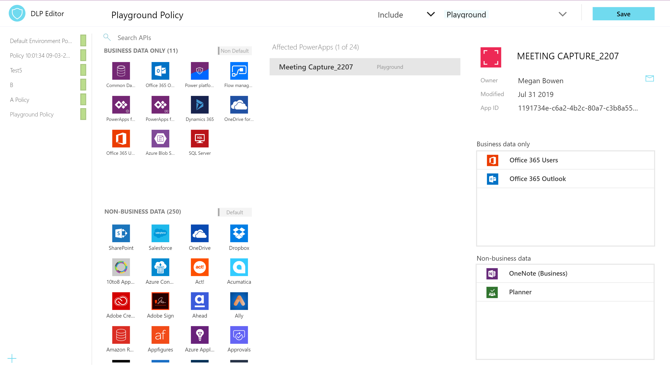
DLP Editor (secure)
See the impact of a DLP policy and mitigate vs. breaking the workflow
Update the policy in the app

Slide 23
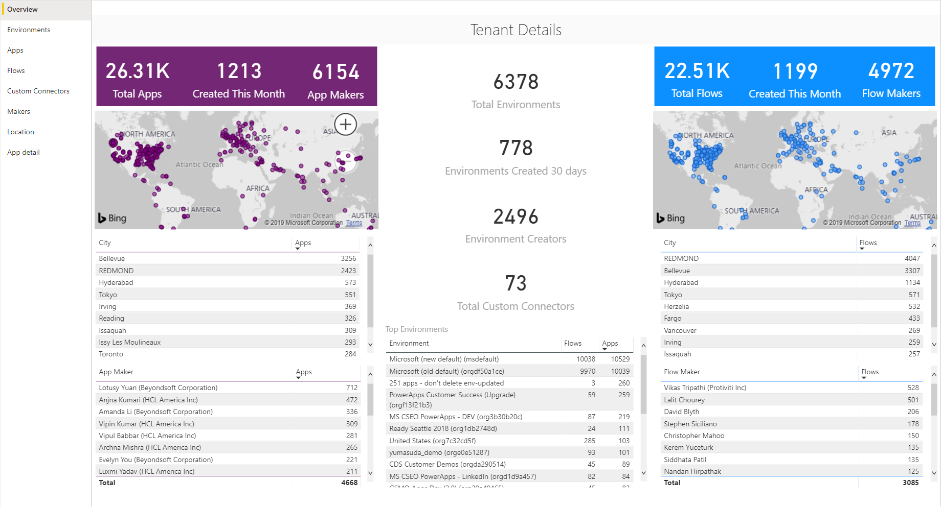
Power BI Dashboard (monitor)
Gain insight into your tenant
All up view of what’s being created
Discover your champions
Incorporate telemetry

Slide 24
Centre of Excellence Starter Kit Components - Nurture
Section | Scenario | Toolkit component
Evangelism & Training | Encourage adoption | Welcome Email (Flow) Training in a Day Management (2 Canvas Apps) ¹ Training in a Day Notifications (Flow) ¹ Newsletter with Product Updates (Flow) ¹
Standards & Components | Guide best practices | Template Catalog (Canvas App) ¹
¹ new since MBAS

Slide 25
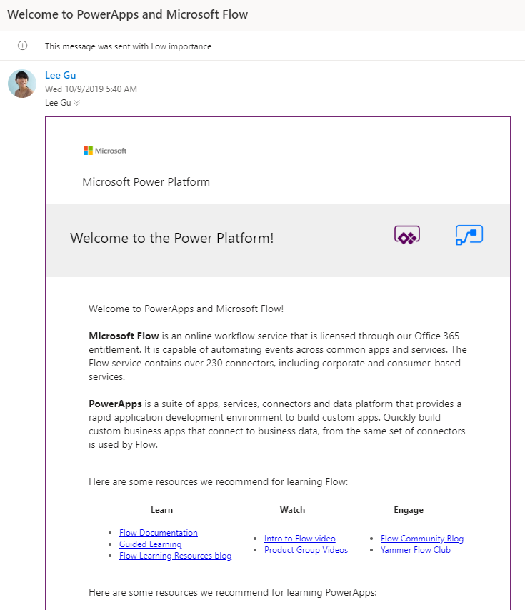
Welcome email (nurture)
Sends an email to makers who create an app, flow or connector for the first time
Adds new makers to an Office 365 Security Group

Slide 26
Framing Today
Secure
Monitor
Alert & Action
Deploy
9:00 - 10:45
10:45 - 12:30
Lunch
1:15 – 3:15
3:15 – 5:30
Welcome & Logistics
Presentation (45)
Questions (15)
Hands on Lab (30)
Questions + Break (15)
Presentation (30)
Questions (15)
CoE Starter Kit Demo (15)
Hands on Lab (45)
Questions + Lunch (45)
Presentation (30)
Questions (15)
Hands on Lab (60)
Questions + Break (15)
Presentation (30)
Questions (15)
Hands on Lab (60)
Wrap-up (30)

Slide 27
Hands on Lab 2 – Monitoring
Objective
Explore CoE Starter Kit
Learn how to enable and make use of monitoring tools, OOB and custom made
PowerApp to monitor activity
Flow to notify admins of activity
Review Office 365 Activity Logging
Notes
Audit logging has already been enabled by global tenant admin in the lab tenant
Getting started
In an In-Private browsing session, go to https://make.powerapps.com
Make sure to be logged in with your Lab Admin credentials
Go to your Central Apps Test – user# environment

Slide 28
Framing Today
Secure
Monitor
Alert & Action
Deploy
9:00 - 10:45
10:45 - 12:30
Lunch
1:15 – 3:15
3:15 – 5:30
Welcome & Logistics
Presentation (45)
Questions (15)
Hands on Lab (30)
Questions + Break (15)
Presentation (30)
Questions (15)
CoE Starter Kit Demo (15)
Hands on Lab (45)
Questions + Lunch (45)
Presentation (30)
Questions (15)
Hands on Lab (60)
Questions + Break (15)
Presentation (30)
Questions (15)
Hands on Lab (60)
Wrap-up (30)

Slide 29
Lunch
Resume at 1:15 PM

Slide 30
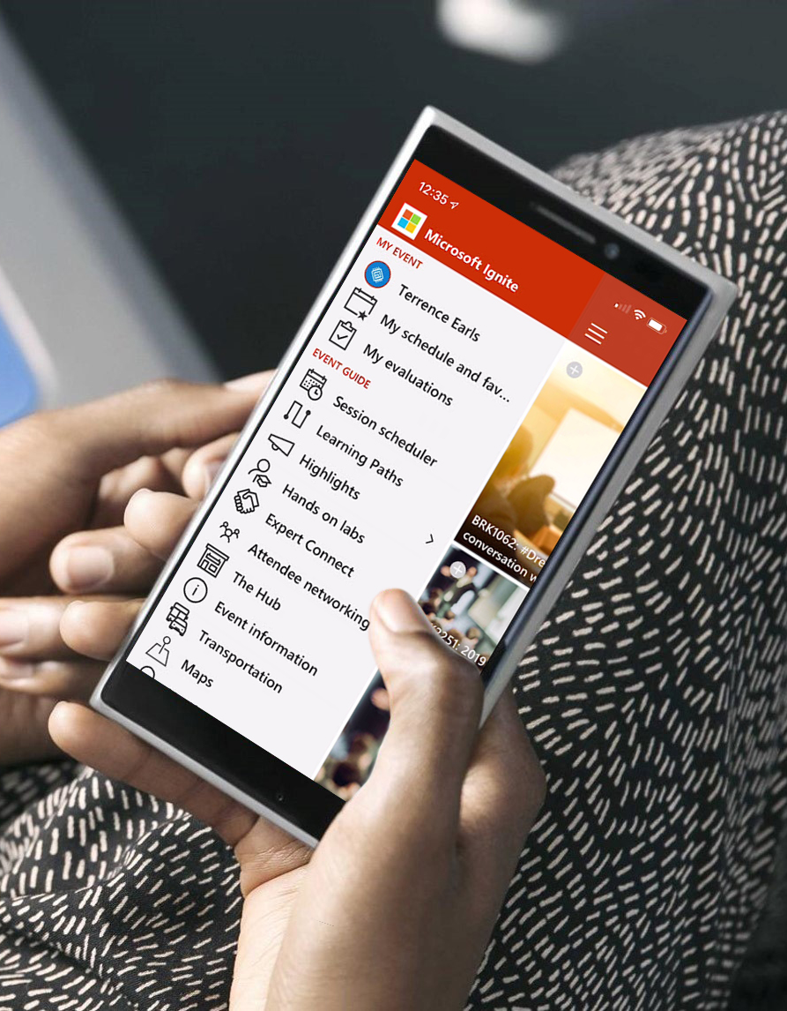
Please evaluate this session Your feedback is important to us!
Please evaluate this session through MyEvaluations on the mobile app or website.
Download the app: https://aka.ms/ignite.mobileapp
Go to the website: https://myignite.techcommunity.microsoft.com/evaluations

Slide 31
Module 3: Alert& Action

Slide 32
Framing Today
Secure
Monitor
Alert & Action
Deploy
9:00 - 10:45
10:45 - 12:30
Lunch
1:15 – 3:15
3:15 – 5:30
Welcome & Logistics
Presentation (45)
Questions (15)
Hands on Lab (30)
Questions + Break (15)
Presentation (30)
Questions (15)
CoE Starter Kit Demo (15)
Hands on Lab (45)
Questions + Lunch (45)
Presentation (30)
Questions (15)
Hands on Lab (60)
Questions + Break (15)
Presentation (30)
Questions (15)
Hands on Lab (60)
Wrap-up (30)

Slide 33
Alert& Action Presentation
James Oleinik
Director of PM,
PowerApps Administration & Governance

Slide 34
Framing Today
Secure
Monitor
Alert & Action
Deploy
9:00 - 10:45
10:45 - 12:30
Lunch
1:15 – 3:15
3:15 – 5:30
Welcome & Logistics
Presentation (45)
Questions (15)
Hands on Lab (30)
Questions + Break (15)
Presentation (30)
Questions (15)
CoE Starter Kit Demo (15)
Hands on Lab (45)
Questions + Lunch (45)
Presentation (30)
Hands on Lab (60)
Questions (15)
Questions + Break (15)
Presentation (30)
Questions (15)
Hands on Lab (60)
Wrap-up (30)

Slide 35
Hands on Lab 3 – Action through Automation
Objective
Automate Environment request and creation with a Flow + Microsoft Forms
Nurture users to help adopt the Power Platform with a Flow that welcomes new makers
Notes
In the Flow, Environment location needs to be lower case (e.g., ‘unitedstates’).
Database creation: 1033 == English language
Getting started
In an In-Private browsing session, go to https://forms.microsoft.com
Make sure to be logged in with your Lab Admin credentials

Slide 36
Framing Today
Secure
Monitor
Alert & Action
Deploy
9:00 - 10:45
10:45 - 12:30
Lunch
1:15 – 3:15
3:15 – 5:30
Welcome & Logistics
Presentation (45)
Questions (15)
Hands on Lab (30)
Questions + Break (15)
Presentation (30)
Questions (15)
CoE Starter Kit Demo (15)
Hands on Lab (45)
Questions + Lunch (45)
Presentation (30)
Questions (15)
Hands on Lab (60)
Questions + Break (15)
Presentation (30)
Questions (15)
Hands on Lab (60)
Wrap-up (30)

Slide 37
Module 3: Deploy

Slide 38
Framing Today
Secure
Monitor
Alert & Action
Deploy
9:00 - 10:45
10:45 - 12:30
Lunch
1:15 – 3:15
3:15 – 5:30
Welcome & Logistics
Presentation (45)
Questions (15)
Hands on Lab (30)
Questions + Break (15)
Presentation (30)
Questions (15)
CoE Starter Kit Demo (15)
Hands on Lab (45)
Questions + Lunch (45)
Presentation (30)
Hands on Lab (60)
Questions (15)
Questions + Break (15)
Presentation (30)
Questions (15)
Hands on Lab (60)
Wrap-up (30)

Slide 39
Module 4: Deploy
James Oleinik
Director of PM,
PowerApps Administration & Governance
Per Mikkelsen
Principal Program Manager
PowerApps ALM

Slide 40
Framing Today
Secure
Monitor
Alert & Action
Deploy
9:00 - 10:45
10:45 - 12:30
Lunch
1:15 – 3:15
3:15 – 5:30
Welcome & Logistics
Presentation (45)
Questions (15)
Hands on Lab (30)
Questions + Break (15)
Presentation (30)
Questions (15)
CoE Starter Kit Demo (15)
Hands on Lab (45)
Questions + Lunch (45)
Presentation (30)
Hands on Lab (60)
Questions (15)
Questions + Break (15)
Presentation (30)
Questions (15)
Hands on Lab (60)
Wrap-up (30)

Slide 41
Hands on Lab 4 – Deploying apps
Objective
Configure Azure DevOps Build Tools to deploy a solution
Deploy the Device Ordering Development team’s solution into Test
Notes
Download Managed solution for deploying to test, Unmanaged for keeping an editable copy of the solution. This is good practice to follow.
In Exercise 3, start portal in preview mode by going to https://make.preview.powerapps.com
Getting started
In an In-Private browsing session, go to https://make.powerapps.com
Make sure to be logged in with your Lab Admin credentials
Go to the Device Ordering Development environment and export the Contoso Device Order Management solution

Slide 42
Framing Today
Secure
Monitor
Alert & Action
Deploy
9:00 - 10:45
10:45 - 12:30
Lunch
1:15 – 3:15
3:15 – 5:30
Welcome & Logistics
Presentation (45)
Questions (15)
Hands on Lab (30)
Questions + Break (15)
Presentation (30)
Questions (15)
CoE Starter Kit Demo (15)
Hands on Lab (45)
Questions + Lunch (45)
Presentation (30)
Hands on Lab (60)
Questions (15)
Questions + Break (15)
Presentation (30)
Questions (15)
Hands on Lab (60)
Wrap-up (30)

Slide 43
Call to action - Resources
Download a collection of components and tools to help you get started aka.ms/CoEStarterKit​
Find training resources, including guided learning and step-by-step guides aka.ms/PowerPlatformLabs​
Read up on customer success stories and find resources relevant to your experience, technical background and skill level aka.ms/PowerPlatformResources​
Get started with the Microsoft Power Platform path on Microsoft Learn, a free online and interactive training platform https://aka.ms/PowerUp​

Slide 44
Please evaluate this session Your feedback is important to us!
Please evaluate this session through MyEvaluations on the mobile app or website.
Download the app: https://aka.ms/ignite.mobileapp
Go to the website: https://myignite.techcommunity.microsoft.com/evaluations
Today’s content:
aka.ms/powerapps/admininadaydownload
aka.ms/coestarterkit
Further Reading:
aka.ms/PowerPlatformResources

